Slide 1
Key words

Slide 2
And
Although
Because
Besides
But

Slide 3
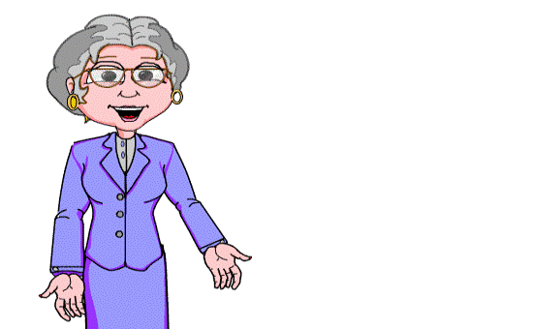
GRAMMAR STUDY:
Linking words

Slide 4
We use linking words ( conjunctions)
to join two sentences.
They make one longer sentence from
two shorter sentences
called clauses:

Slide 5
And
We use and
to join two sentences.
For example:
I sent Mary an e–mail
and she answered me.

Slide 6
But
We use but to
show contrast.
For example:
I sent Mary an e-mail but
she didn´t answer me.

Slide 7
Because
We use because to express
a reason for
something happening.
For example:
She didn´t answer me
because she was ill.

Slide 8
so
The word so expresses a result
and is preceded by a comma.
For example:
She was ill in bed, so she
didn´t read her e-mails.

Slide 9
or
The word or introduces
an alternative.
For example:
I can send her an e-mail or
phone her

Slide 10
When
When means at the time that
something happened
or happens.
For example:
I last talked to her when we
were in the English class.

Slide 11
Questions?

